Slide 1

HeatScape
AI-Driven Detection and Mitigation of Urban Heat Island Effects Using Image Analysis and IoT
R25 - 002

Slide 2



Supervisors
Mr. Vishan Jayasinghearchchi
Supervisor
Ms. Kaushalya Rajapakse
Co-Supervisor
Dr.Rajitha de Silva
External Supervisor

Slide 3


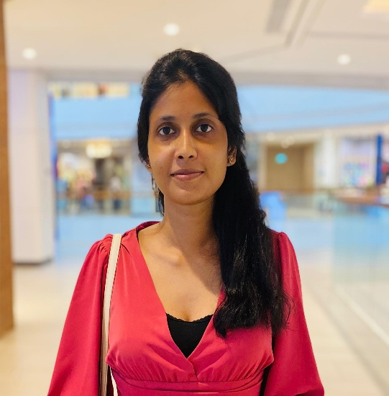

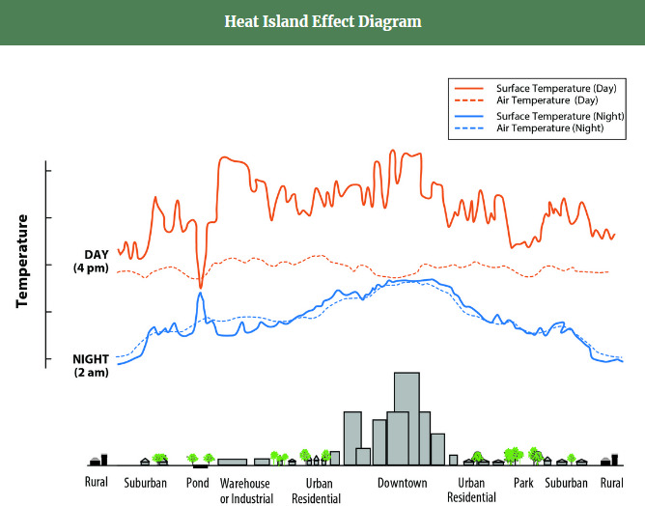
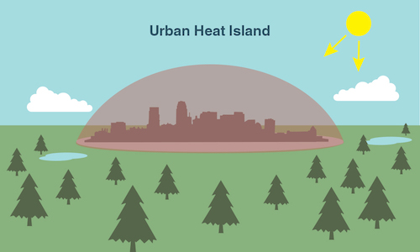
Team Members
Ayeshmantha S. K. S.
IT21219320
Kumara B.D.A.N
IT21256264
Silva G. M. S. S
IT21802126
Madhuwantha G K O
IT21802058

Slide 4


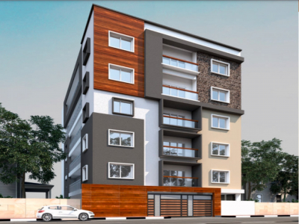
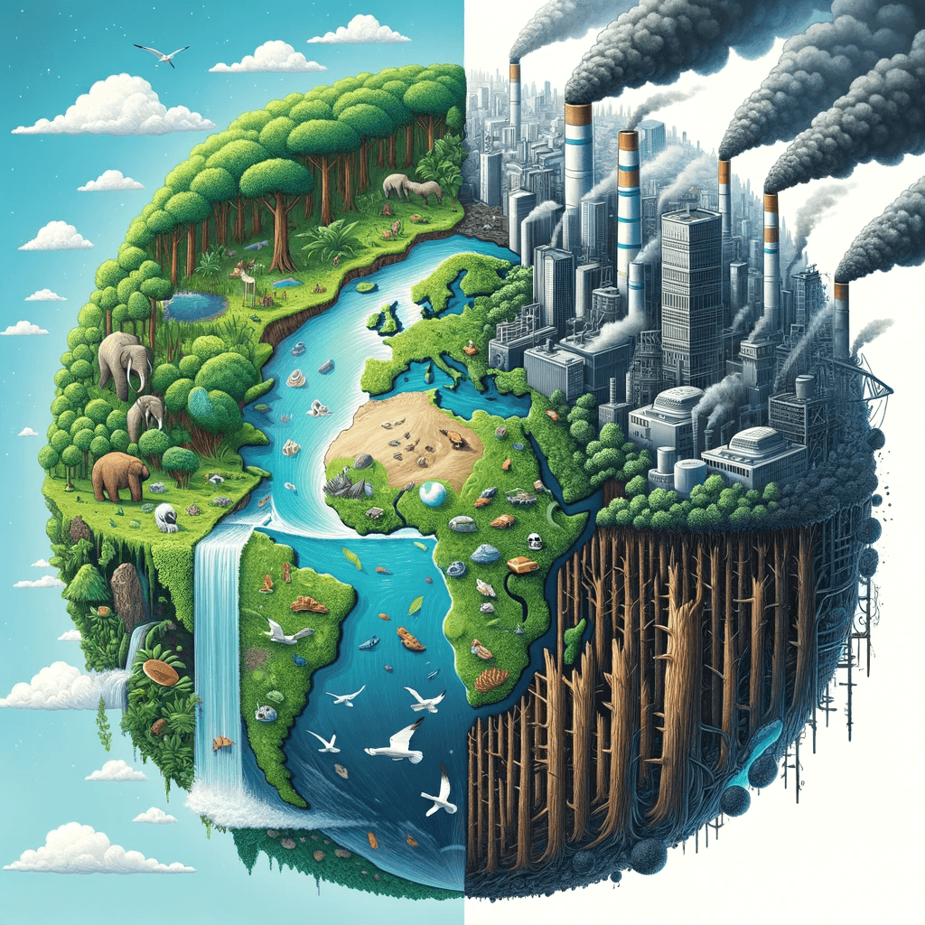
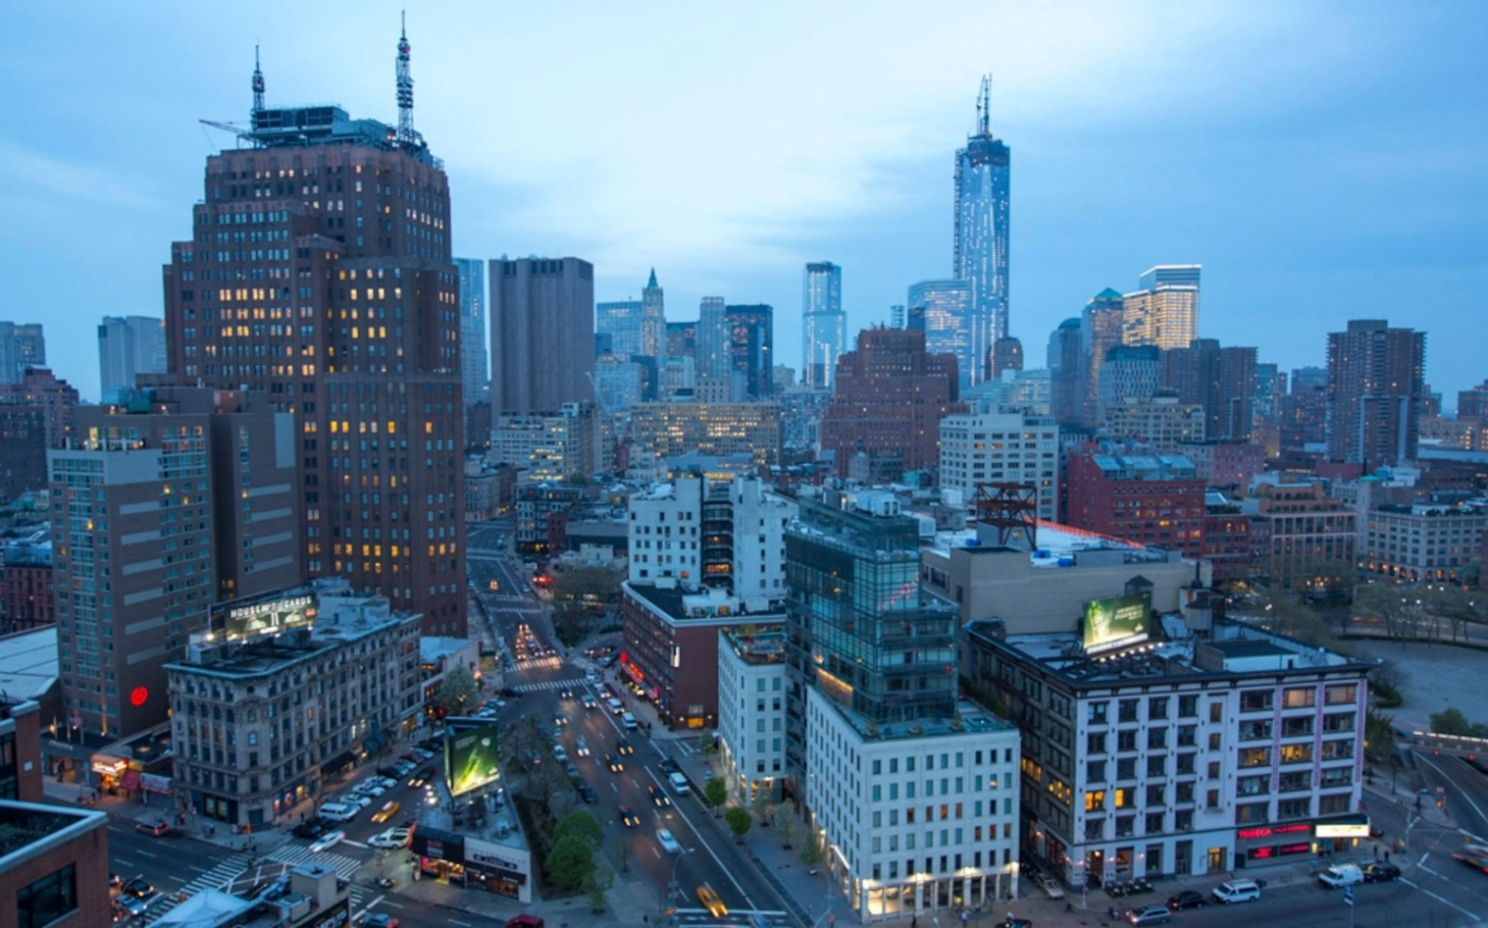
Introduction
Elevated temperatures in urban areas compared to their rural surroundings.

Slide 5
Research Question
How can AI-driven image analysis and IoT-based data collection improve the detection and mitigation of Urban Heat Island effects in urban areas?

Slide 6




Objectives

Slide 7
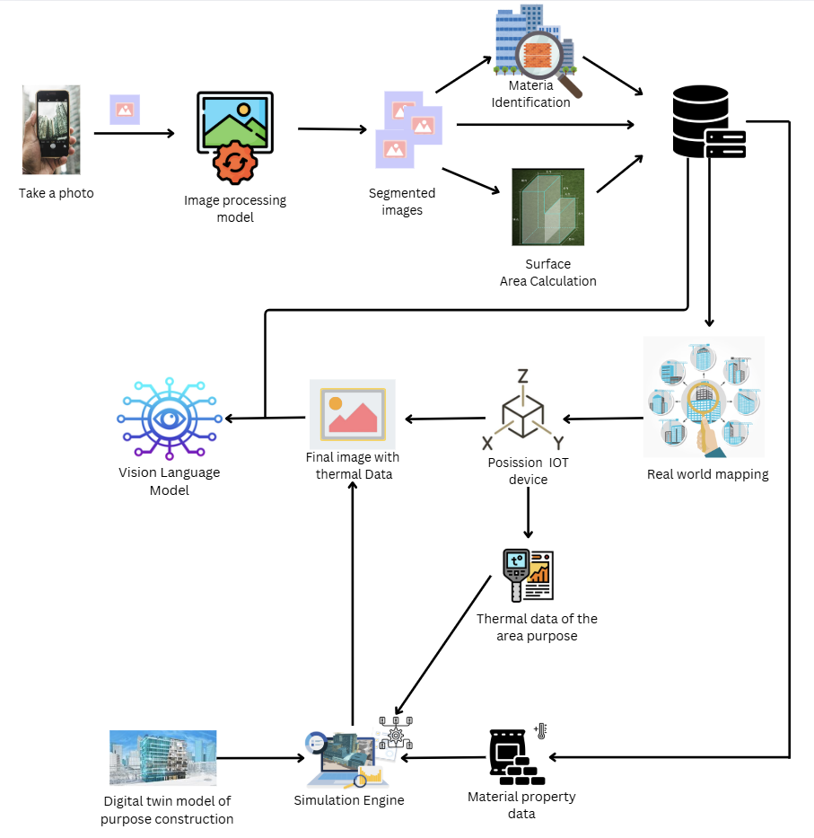
System Diagram

Slide 8
IT21256264 | KUMARA B.D.A.N.
Software Engineering
IT21256264 | Kumara B.D.A.N | R25-002

Slide 9
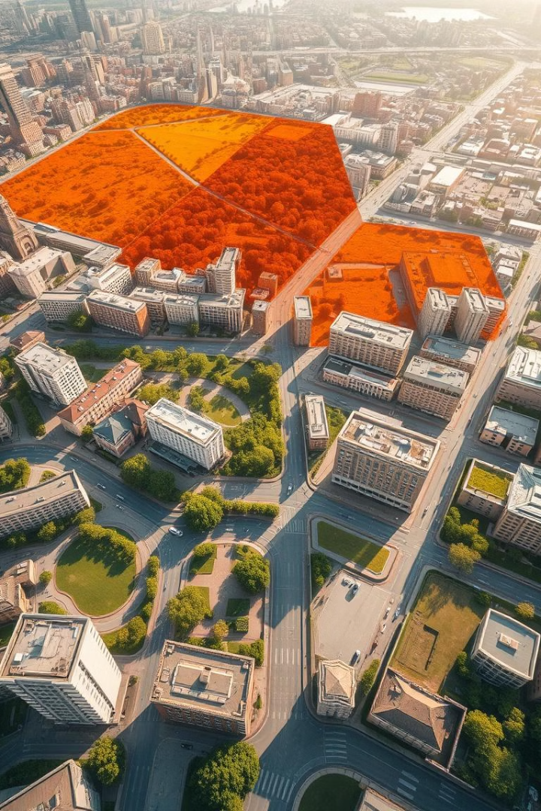
Optimizing Object Detection and Segmentation Integration for Real-Time Urban Scene Analysis
IT21256264 | Kumara B.D.A.N | R25-002
Notes:
my research on Optimizing Object Detection and Segmentation Integration for Real-Time Urban Scene Analysis.

Slide 10
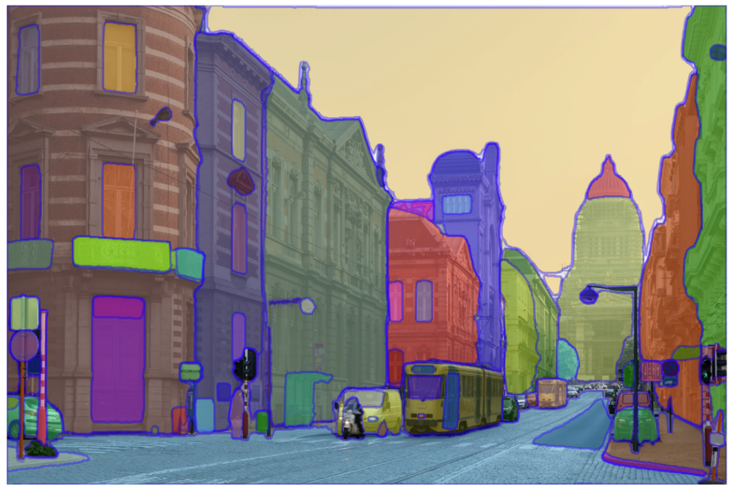
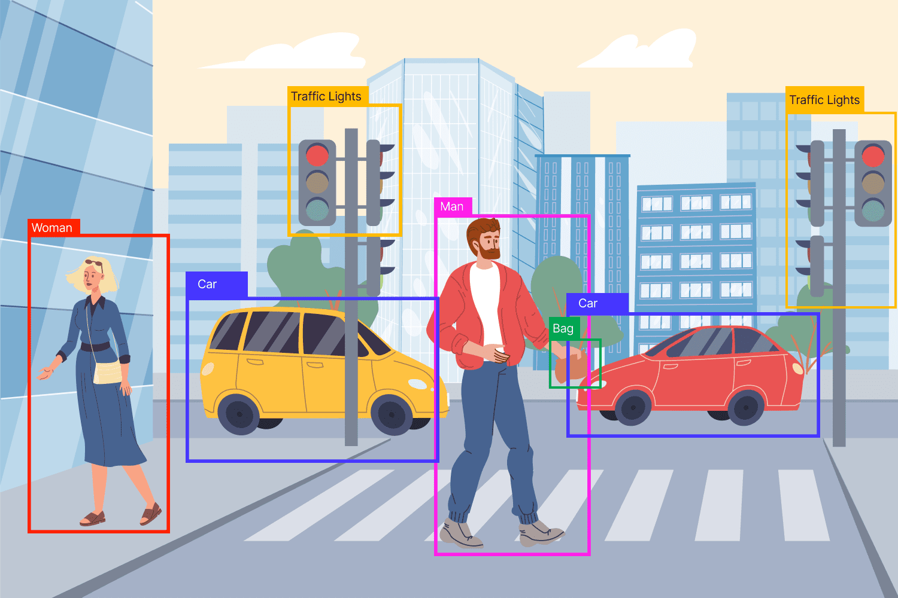
Introduction
Integration with Object Detection
Semantic Segmentation
Material Classification
Surface Area Calculation
IT21256264 | Kumara B.D.A.N | R25-002
Notes:
This study focuses on how AI can help analyze and mitigate urban heat island effects through advanced image processing techniques.

Slide 11
Research Gap
Paper A: “Existing methods do not combine segmentation, material classification, and surface area calculation into a unified framework”[1]
Paper B: "Models struggle to perform consistently across varied urban landscapes with different structures, lighting, and materials “[2]
Paper C: "Surface area estimation is often disconnected from segmentation and material workflows, reducing accuracy “[3]
IT21256264 | Kumara B.D.A.N | R25-002

Slide 12
Research Question
How can SAM be optimized for precise segmentation of urban components?
What methods are effective for classifying materials (e.g., concrete, glass) of segmented components?
How can surface areas of segmented components be accurately calculated?
How can YOLOv8 and SAM be integrated into a unified framework for urban analysis?
IT21256264 | Kumara B.D.A.N | R25-002

Slide 13
Specific and Sub Objectives
Fine-tune SAM to improve segmentation accuracy
on urban datasets like Cityscapes and ADE20K
1
Develop a framework integrating YOLOv8 and SAM for precise segmentation, material classification, and surface area calculation in urban thermal analysis.
2
Design and validate machine learning algorithms
for material classification with minimal labeled data
Develop an efficient surface area estimation module
using pixel-based scaling or geometric modeling
3
IT21256264 | Kumara B.D.A.N | R25-002

Slide 14
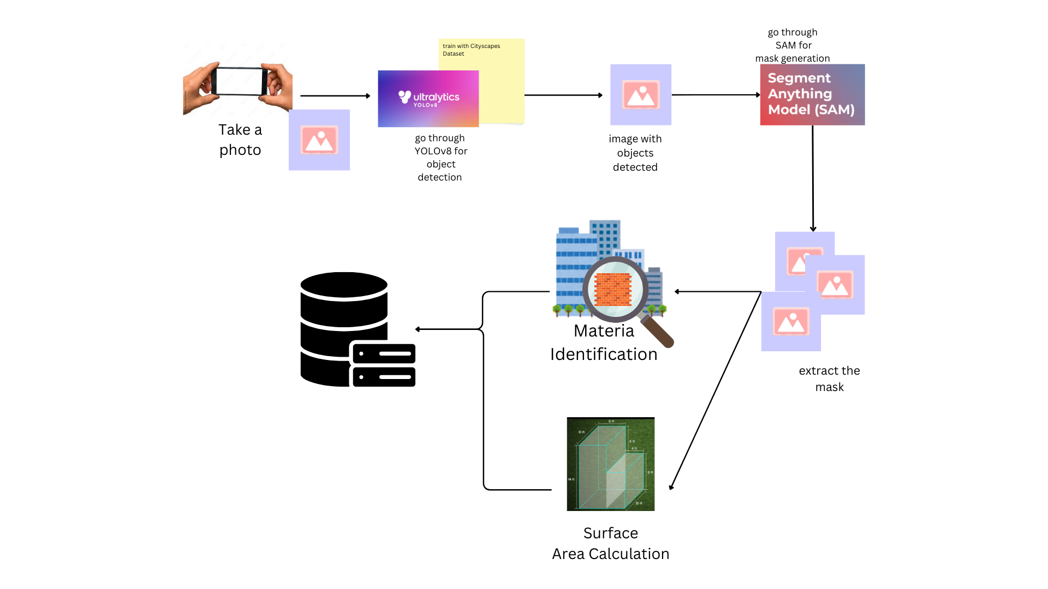
System Diagram
IT21256264 | Kumara B.D.A.N | R25-002

Slide 15



TECHNOLOGIES, TECHNIQUES & ALGORITHMS
Technologies
Techniques
Algorithms
YOLOv8
Segment Anything Model (SAM)
Python
PyTorch
OpenCV
Semantic Segmentation
Material Classification
Surface Area Estimation
Data Augmentation
Convolutional Neural Networks (CNNs)
Mask Refinement Algorithms
IoU (Intersection over Union)
IT21256264 | Kumara B.D.A.N | R25-002
Notes:
This system uses YOLOv8 and SAM for detection and segmentation, along with Python, PyTorch, and OpenCV for implementation. Key techniques include semantic segmentation, material classification, and data augmentation, while algorithms like CNNs and Intersection over Union (IoU) ensure accuracy.

Slide 16



System, personal, and software Requirements specification
System Requirements
Personal Requirements
Software Requirements
High-Performance GPUs
Processor
RAM
Storage
Proficiency in Python and deep learning frameworks (e.g., PyTorch).
Understanding of semantic segmentation and object detection workflows.
Experience with image processing libraries (e.g., OpenCV).
Functional Requirements
Object Detection
Semantic Segmentation
Material Classification
Surface Area Calculation
Non-Functional Requirements
Performance
Reliability
Scalability
Security
IT21256264 | Kumara B.D.A.N | R25-002
Notes:
For implementation, high-performance GPUs are essential. Developers must be proficient in Python, deep learning, and image processing. Software requirements include PyTorch, OpenCV, and cloud storage for datasets.

Slide 17
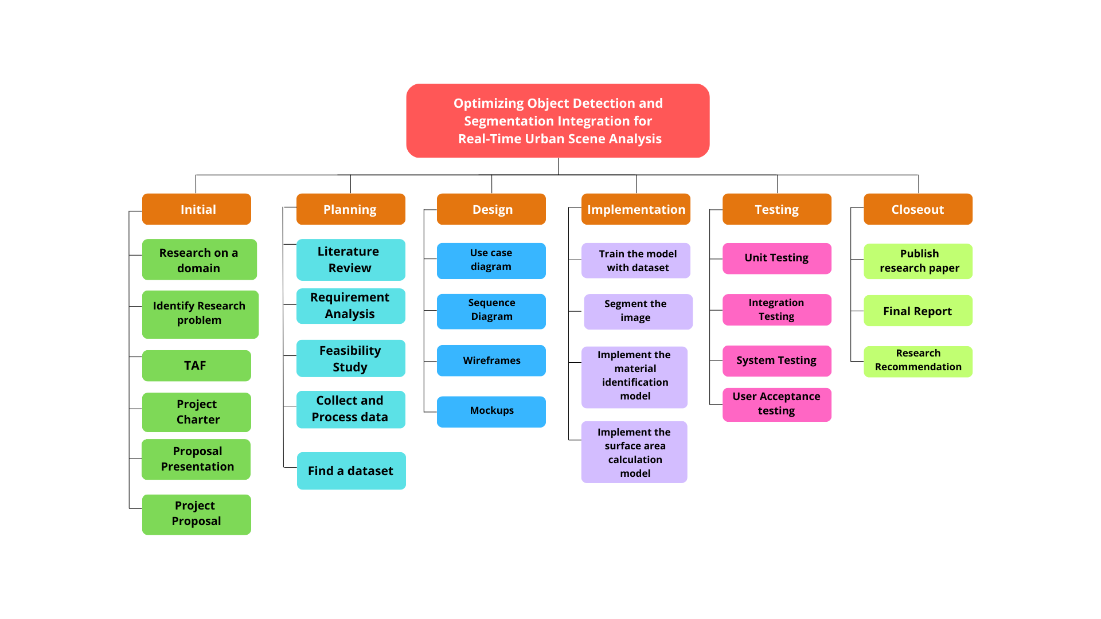
WORK BREAKDOWN STRUCTURE
IT21256264 | Kumara B.D.A.N | R25-002
Notes:
The project follows a structured workflow, starting from data collection and model training to system integration and evaluation

Slide 18
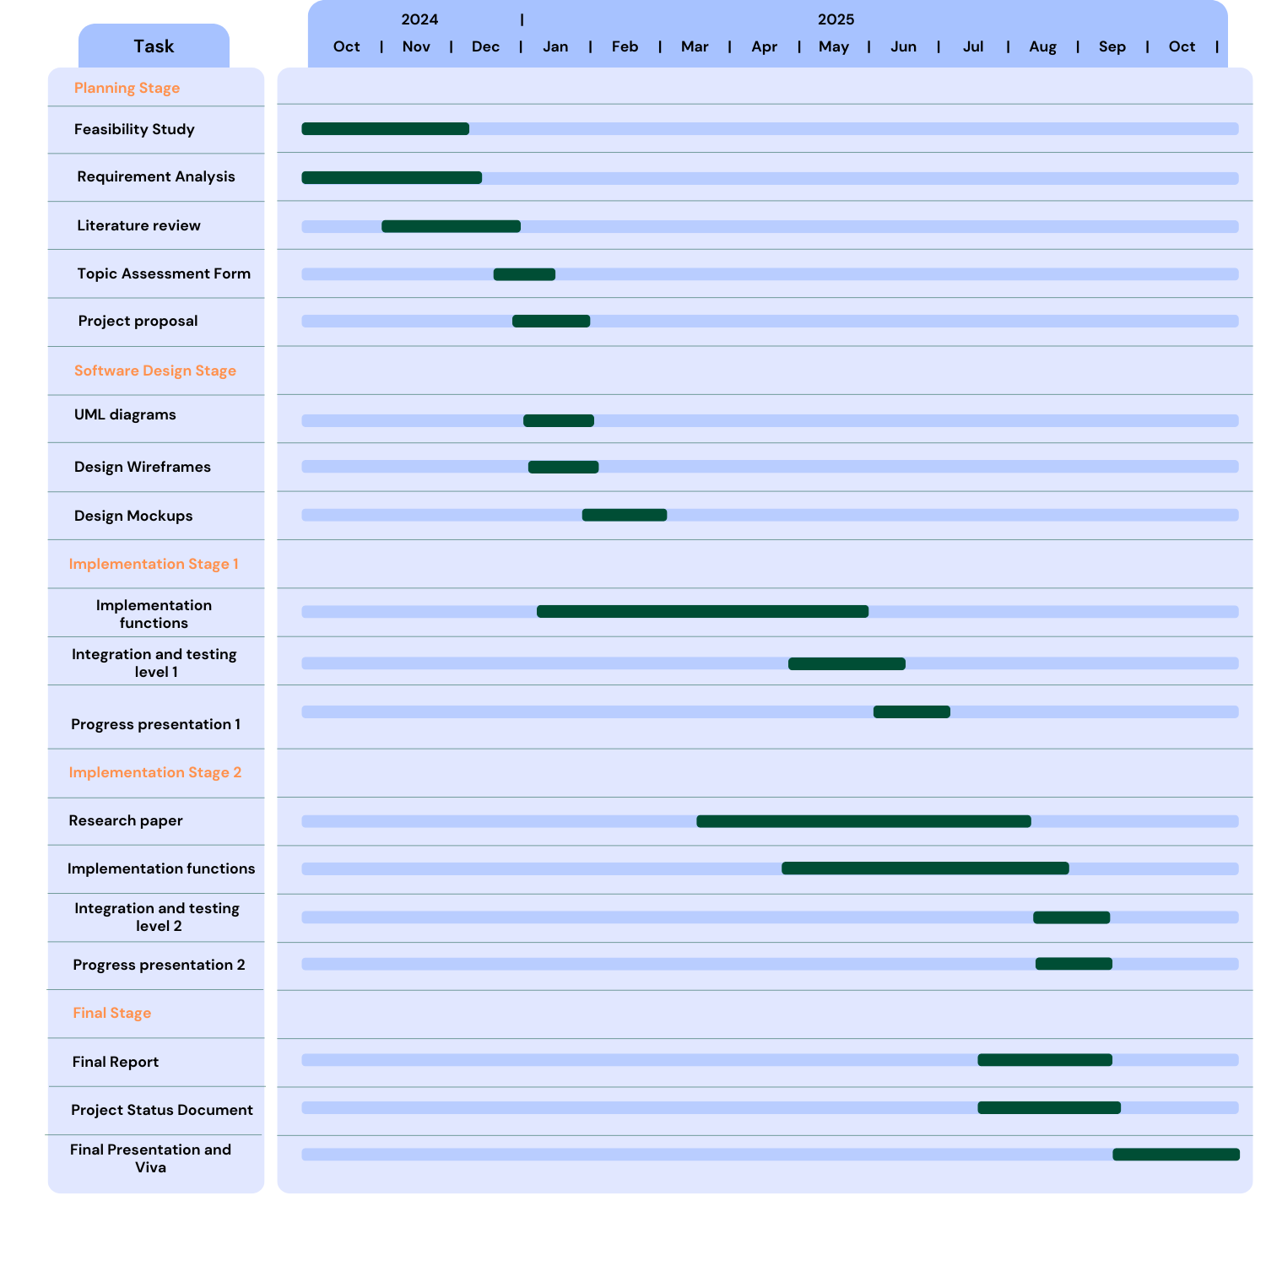
Gannt Chart
IT21256264 | Kumara B.D.A.N | R25-002
Notes:
. A Gantt chart ensures efficient time management throughout these stages

Slide 19

Commercialization
Target Audience
Market space
Urban Planning and Development Firms
Environmental Management Agencies
Real Estate and Construction Companies
IoT and Smart City Solutions Providers
Urban Planning and Development
Environmental Sustainability and Research
Smart City Technologies
IT21256264 | Kumara B.D.A.N | R25-002

Slide 20
Budget Plan
Requirement | Price (Rs.)
Cloud Computing Service | 10000
Domain Registration | 4000
Hardware Products | 20000
Total estimated cost | 34000
IT21256264 | Kumara B.D.A.N | R25-002

Slide 21
References
[1] O. Ronneberger, P. Fischer, and T. Brox, “U-Net: Convolutional Networks for Biomedical Image Segmentation,” arXiv preprint arXiv:1505.04597, 2015. [Online]. Available: https://arxiv.org/abs/1505.04597.
[2] S. Bell, P. Upchurch, N. Snavely, and K. Bala, “Material Recognition in the Wild with the Materials in Context Database,” in Proc. IEEE Conf. Comput. Vis. Pattern Recognit. (CVPR), 2015, pp. 3475–3483. [Online]. Available: https://arxiv.org/abs/1412.0623.
[3] R. C. Gonzalez and R. E. Woods, Digital Image Processing, 3rd ed., Pearson, 2008.
IT21256264 | Kumara B.D.A.N | R25-002

Slide 22

IT21219320 | Ayeshmantha S. K. S.
Software Engineering
IT21219320 | Ayeshmantha S. K. S. | R25-002

Slide 23
IoT-Driven Thermal Mapping for Precision Heat Island Detection
IT21219320 | Ayeshmantha S. K. S. | R25-002

Slide 24
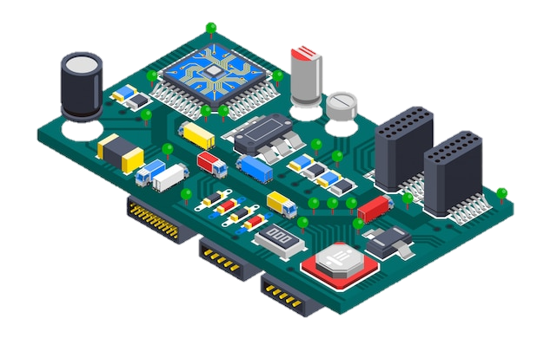
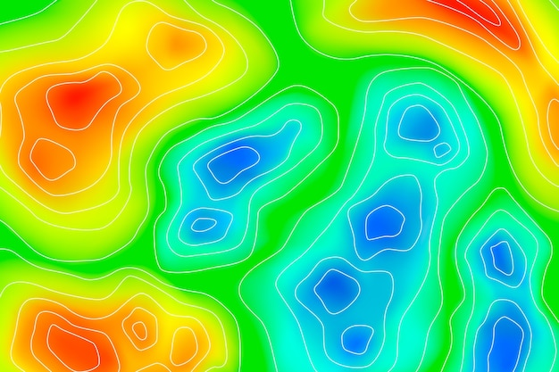
Introduction
IoT Device Integration
Collect real-time environmental data
Map data to image
IT21219320 | Ayeshmantha S. K. S. | R25-002

Slide 25
Research Gap
Paper A: "Design and Implementation of Low Cost IoT Sensor System for Urban Heat Island Observation“ [1]
Paper B: "Mobile technologies and services for environmental monitoring: The Citi-Sense-MOB approach“[2]
Paper C: "Automatic Estimation for Visual Quality Changes of Street Space via Street-View Images and Multimodal Large Language Models“[3]
IT21219320 | Ayeshmantha S. K. S. | R25-002

Slide 26

Research Question
How to synchronize data between IoT sensors and segmented image areas to maintain spatial accuracy?
How to process and integrate temperature data from IoT sensors and image-based analysis quickly and accurately?
How to design a compact and energy-efficient IoT device that can sustain long-term deployments in outdoor environments?
IT21219320 | Ayeshmantha S. K. S. | R25-002
Notes:
Building on the challenges identified in the research gap, I face three fundamental questions critical to advancing in the development of the iot device:
How to synchronize data between IoT sensors and segmented image areas to maintain spatial accuracy?
This ensures temperature readings are precisely matched to specific geographic and material areas, allowing for reliable analysis and insights.
How to process and integrate temperature data from IoT sensors and image-based analysis quickly and accurately?
Timely and accurate data processing is vital for real-time decision-making, especially in rapidly changing urban environments.
How to design a compact and energy-efficient IoT device that can sustain long-term deployments in outdoor environments?
This addresses the practical challenges of deploying sensors that are affordable, reliable, and resilient in varying weather conditions.
Together, these questions guide towards creating a solution that is precise, efficient, and scalable for urban planning and policy-making.

Slide 27
Specific and Sub Objectives
Design and Develop a Compact, Energy-Efficient IoT
Device for Real-Time Environmental Data Collection
1
Collect accurate temperature data for the specified segments and map the thermal data into the image
2
Ensure Accurate Data Synchronization Between
Image Analysis and Real-World Mapping
Implement Efficient Data Processing Techniques
for Accurate Heat Island Detection and Mitigation
Insights
3
IT21219320 | Ayeshmantha S. K. S. | R25-002

Slide 28
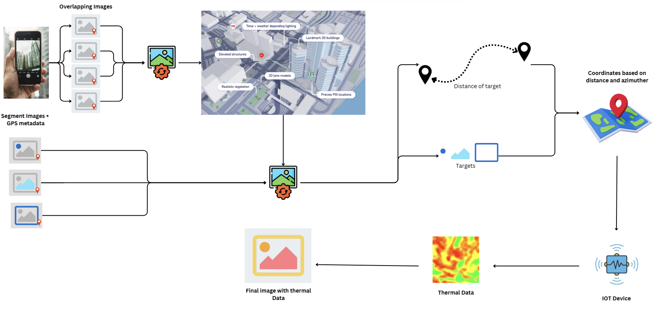
Methodology
IT21219320 | Ayeshmantha S. K. S. | R25-002
Notes:
This is my components system diagram,

Slide 29
TECHNOLOGIES, TECHNIQUES & ALGORITHMS
Technologies
Techniques
Algorithms
Flutter
Python
Flask
NodeJS
OpenCV
ESP32
AMG8833 IR Sensor
Servos
Geospatial Tagging
Edge Computing
Data Caching
Photogrammetry
Moving Average
Outlier Detection Algorithms
Linear Regression
KNN (K-Nearest Neighbors)
PID Control (Proportional-Integral-Derivative)
IT21219320 | Ayeshmantha S. K. S. | R25-002

Slide 30
System, personal, and software Requirements specification
System Requirements
Personal Requirements
Software Requirements
ESP32
AMG8833
DHT22
TSL2561
Servos
Battery pack
Smart Phone
Laptop
Proficiency in C/C++
Python
Arduino IDE
MQTT
API Development
Functional Requirements
Data Collection and Transmission
Actuator Control
Auto Positioning
Attach Thermal Data
Non-Functional Requirements
Performance
Reliability
Scalability
IT21219320 | Ayeshmantha S. K. S. | R25-002

Slide 31
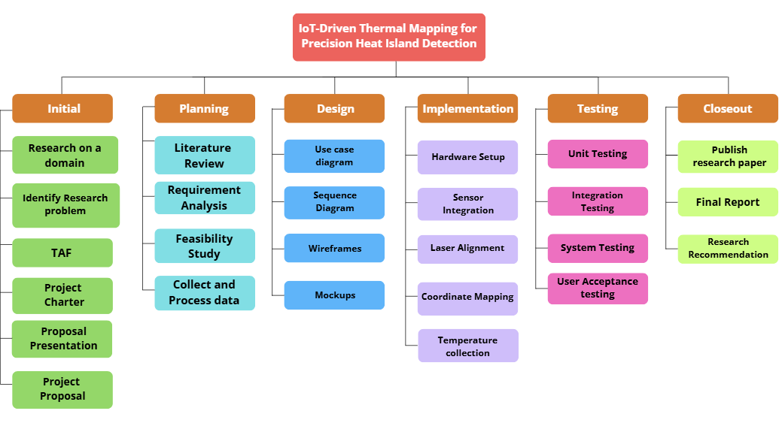
WORK BREAKDOWN STRUCTURE
IT21219320 | Ayeshmantha S. K. S. | R25-002

Slide 32
Gannt Chart
IT21219320 | Ayeshmantha S. K. S. | R25-002

Slide 33
Commercialization
Target Audience and Market Space
Market space
Target audience
Urban Planners and City Officials
Environmental Agencies and NGOs
Researches
innovators
IoT and sensor technologies
Green infrastructure
Construction technologies
IT21219320 | Ayeshmantha S. K. S. | R25-002

Slide 34
Budget Plan
Requirement | Price (Rs.)
Cloud Computing Service | 10000
Domain Registration | 4000
Hardware Products | 30000
Wi-fi charges | 6000
Transportation | 5000
Other | 5000
Total estimated cost | 60000
IT21219320 | Ayeshmantha S. K. S. | R25-002

Slide 35
References
[1] Y. K. Tan and S. K. Panda, "Design and Implementation of Low Cost IoT Sensor System for Urban Heat Island Observation," in 2021 IEEE International Conference on Smart Instrumentation, Measurement and Applications (ICSIMA), Kuala Terengganu, Malasiya, 2021.
[2] M. K. H.-Y. L. P. S. W. L. A. J. B. Nuria Castell, "Mobile technologies and services for environmental monitoring: The Citi-Sense-MOB approach," ScienceDirect, vol. 14, pp. 370-382, 2015.
[3] N. I. F. I. A. N. Vina Nurul Husna, "Measuring And Mitigating Urban Heat Island In Yogyakarta City Using Remote Sensing," INTERNATIONAL JOURNAL OF SCIENTIFIC & TECHNOLOGY RESEARCH , vol. 7, no. 7, 2018.
IT21219320 | Ayeshmantha S. K. S. | R25-002

Slide 36

IT21802126 | Silva G. M. S. S
Software Engineering
IT21802126 | Silva G. M. S. S | R25-002

Slide 37
Standardized Data Integration and VLM Optimization for Urban Heat Island Mitigation
IT21802126 | Silva G. M. S. S | R25 - 002
Notes:
Thank you sachinthaka. I am Sandithya Silva. Today, I’ll be presenting my research on "Standardized Data Integration and VLM Optimization for Urban Heat Island Mitigation." This study explores how to utilize Vision-Language Models, for addressing the urban heat island effect, offering innovative AI-driven solutions for sustainable cities.

Slide 38

Introduction
Analyze urban images with material, area, and temperature data.
Use Vision-Language Models (VLMs) for interpreting multimodal inputs.
Standardize data formats for consistent input to VLMs.
Fine-tune prompts to extract insights for urban cooling strategies.
Provide recommendations for material and structural changes based on data analysis.
IT21802126 | Silva G. M. S. S | R25 - 002
Notes:
This research focuses on analyzing urban images alongside material, surface area, and temperature data to address urban heat islands. VLM help interpret this data. By standardizing inputs and refining prompts, the system provides insights and practical recommendations to reduce heat retention in cities through material and structural changes.

Slide 39
Research Gap
Paper A: "Advancing Urban Development through Vision-Language Models: Applications and Challenges of Satellite Imagery Analysis“ [1]
Paper B: "A Study on Performance Improvement of Prompt Engineering for Generative AI with a Large Language Model“[2]
Paper C: "Automatic Estimation for Visual Quality Changes of Street Space via Street-View Images and Multimodal Large Language Models“[3]
IT21802126 | Silva G. M. S. S | R25 - 002
Notes:
In reviewing the existing research, I’ve identified three key works that highlight gaps my research addresses.
In Paper A focuses on using VLM for analyzing satellite imagery to advance urban development. While it’s valuable, my research goes further by integrating ground-level urban images, material predictions, and IoT-based temperature data. This provides a much more localized and detailed analysis specifically targeting urban heat islands.
Paper B examines improving prompt engineering for generative AI with large language models. Similarly, my research involves prompt engineering, but with a unique application standardizing and tailoring prompts for multimodal inputs like image segmentation, surface areas, and real-time temperature data. This ensures the outputs are actionable and relevant to urban cooling strategies.
Paper C uses street-view images with multimodal models to estimate visual quality changes in urban spaces. My work expands on this by including thermal and material analysis of urban structures, making it possible to generate practical recommendations for mitigating heat retention an application that goes beyond aesthetics and focuses on sustainability.

Slide 40
Research Questions
How to standardize and integrate multimodal data for VLM input?
How to fine-tune VLM prompts for insights on urban cooling strategies?
How to maintain scalability and accuracy when analyzing large-scale image data?
How to generate actionable recommendations based on standardized data for material and structural changes?
IT21802126 | Silva G. M. S. S | R25 - 002
Notes:
To achieve these goals, I have posed four key research questions:
How can multimodal data be standardized and integrated effectively for VLMs?
What prompt engineering techniques work best for extracting insights from VLMs?
How can the system remain scalable and accurate when dealing with large-scale image data?
How can actionable recommendations be generated from this data for urban cooling strategies?

Slide 41
Specific and Sub Objectives
1
Formalize and preprocess data for standardized
VLM input.
Accurately standardize and integrate multimodal data to generate actionable insights using VLMs
2
Fine-tune VLM prompts to extract details on material
properties, thermal traits, and urban changes.
Ensure scalability of data while preserving
image resolution and accuracy.
3
Generate actionable recommendations for material
adjustments, structural changes, and urban
cooling strategies
4
IT21802126 | Silva G. M. S. S | R25 - 002
Notes:
This research has four objectives:
Formalizing and preprocessing multimodal data for standardized VLM inputs.
Fine-tuning VLM prompts to extract details about materials, thermal properties, and urban structures.
Ensuring scalability of the data analysis process without compromising image resolution or accuracy.
Generating actionable recommendations for material and structural adjustments.

Slide 42
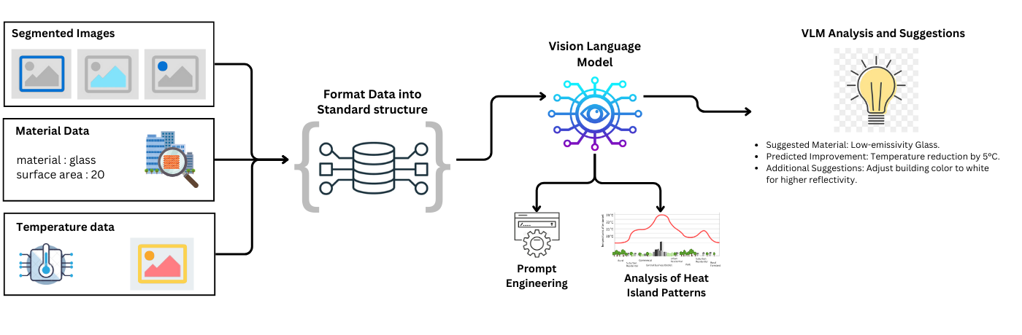
Methodology
IT21802126 | Silva G. M. S. S | R25 - 002
Notes:
This diagram represents the workflow of my research system
First, segmented images are analyzed to identify objects and surfaces. Then, material data, like glass or concrete types and surface area, is combined with real-time temperature data from IoT devices.
All this information is organized into a standard format and sent to a VLM.
Using prompt engineering, we design specific prompts to fine-tune the VLM for analyzing heat patterns and generating actionable suggestions.
For example, the VLM may recommend using low-emissivity glass to reduce heat retention, predict temperature improvements, or suggest using reflective building colors.
This approach combines image processing, temperature analysis, and prompts for the VLM to generate actionable insights for cooling cities."

Slide 43
TECHNOLOGIES, TECHNIQUES & ALGORITHMS
Technologies
Techniques
Algorithms
Python
TensorFlow
NumPy
Pandas
OpenCV
Hugging Face Transformers
Flask Server
Google Colab
Jupyter Notebook
Data Preprocessing (Image/Text formatting)
Prompt Engineering for VLMs
Data Standardization
Multimodal Data Integration
Scalability Testing
Vision Transformer (ViT)
ResNet (Residual Networks)
BERT or GPT
IT21802126 | Silva G. M. S. S | R25 - 002
Notes:
This system uses techniques like Data Preprocessing for formatting images, text, and JSON, along with Prompt Engineering to fine-tune Vision-Language Models (VLMs). Key methods include Data Standardization for uniform input structures, Multimodal Data Integration to combine image and IoT data, and Scalability Testing to ensure the system handles large datasets effectively.
This system utilizes Vision-Language Models (VLMs) and prompt engineering for analysis, with Python as the primary implementation language. Key techniques include Data Preprocessing for formatting images, and text, material prediction, and IoT-based temperature integration. The workflow standardizes multimodal inputs into structured formats for the VLM, ensuring accurate analysis of urban heat patterns and generation of actionable recommendations. while algorithms like ViT and GPT ensure accuracy.

Slide 44
System, personal, and software Requirements specification
Software Requirements
Functional Requirements
Data Upload and Integration
Standardized Data Formatting
Image Preprocessing
Multimodal Data Integration
Prompt Engineering
Standard Output Generation
Analysis and Recommendations
Non-Functional Requirements
Performance
Reliability
Security
User Interface
Scalability
Accuracy
System Requirements
Personal Requirements
Processor
High-Performance GPUs
RAM
Storage
Proficiency in Python.
Familiarity with deep learning frameworks (e.g., PyTorch).
Ability to fine-tune VLMs using prompt engineering.
IT21802126 | Silva G. M. S. S | R25 - 002
Notes:
The project involves system, personal, and software requirements:
System Requirements: High-performance GPUs and adequate storage.
Personal Requirements: Proficiency in Python and VLM fine-tuning.
Software Requirements: Functional elements include data upload, preprocessing, integration, and analysis.
Non-functional requirements include scalability, reliability, and user interface design.

Slide 45
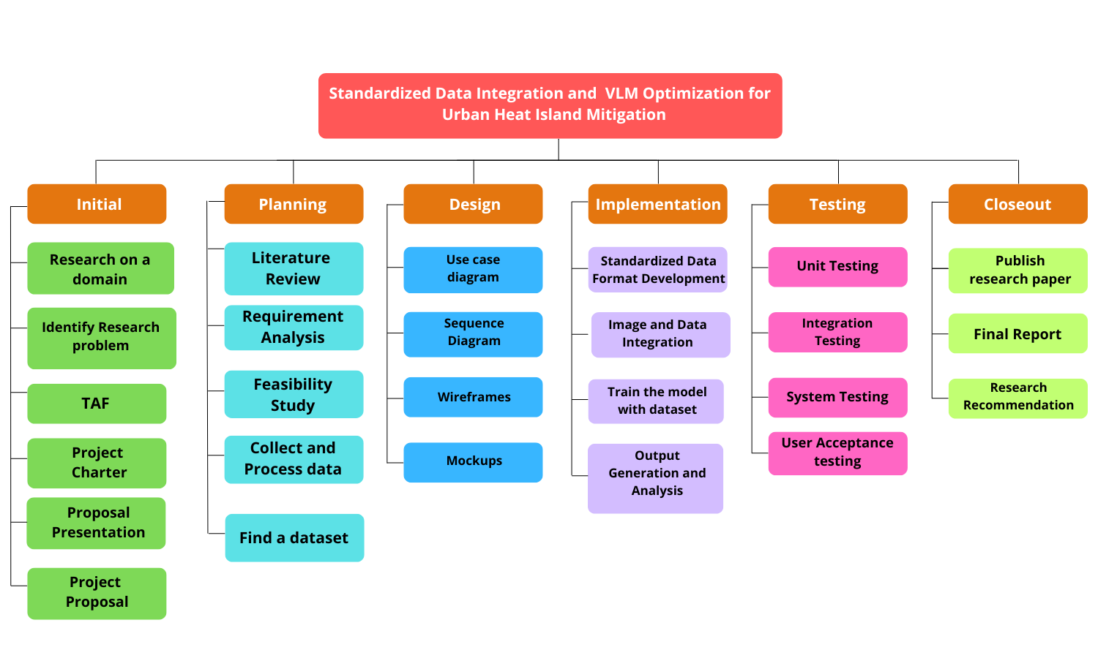
WORK BREAKDOWN STRUCTURE
IT21802126 | Silva G. M. S. S | R25 - 002
Notes:
The work breakdown structure includes tasks such as data collection, preprocessing, prompt engineering, model fine-tuning, testing, and generating final recommendations. This ensures a structured and systematic approach to achieving the research objectives.

Slide 46
Gannt Chart
IT21802126 | Silva G. M. S. S | R25 - 002
Notes:
The timeline for this research is outlined in the Gantt chart, ensuring key milestones are met on schedule.

Slide 47
Commercialization
Market space
Target Audience and Market Space
Vision-Language Models
IoT systems
Green infrastructure
AI-based urban solutions
Urban planners
environmental agencies
Researchers
Innovators.
IT21802126 | Silva G. M. S. S | R25 - 002
Notes:
This research targets urban planners, environmental agencies, researchers, and innovators. The market space includes Vision-Language Models, IoT systems, green infrastructure, and AI-based urban solutions. The potential for real-world impact in sustainable urban planning is significant.

Slide 48
Budget Plan
Requirement | Price (Rs.)
Cloud Computing Service | 10000
Domain Registration | 4000
Hardware Products | 30000
Wi-fi charges | 6000
Transportation | 5000
Other | 5000
Total estimated cost | 60000
IT21802126 | Silva G. M. S. S | R25 - 002
Notes:
The budget plan outlines the financial feasibility of the project, including costs for hardware, software, and research resources. Keeping costs efficient ensures the project remains accessible and impactful.

Slide 49
References
[1] J. Z. Y. L. B. W. J. H. Hao Liang, "Automatic Estimation for Visual Quality Changes of Street Space via
Street-View Images and Multimodal Large Language Models," IEEE Journals & Magazine, vol. 61, no. 9,
pp. 1-10, 2023.
[2] G.-t. A. C. K. C. G. K. Daeseung Park, "A Study on Performance Improvement of Prompt Engineering
for Generative AI with a Large Language Model," IEEE Transactions on Neural Networks and Learning Systems, vol. 34, no. 12, pp. 1-9, 2023.
[3] J. Z. Y. L. Hao Liang, "Automatic Estimation for Visual Quality Changes of Street Space via Street-View Images and Multimodal Large Language Models," IEEE Journals & Magazine, vol. 61, no. 12, pp. 1-13, 2023.
IT21802126 | Silva G. M. S. S | R25 - 002
Notes:
In conclusion, this research aims to provide a scalable, AI-driven framework for mitigating urban heat islands through standardized data integration and VLM optimization.
Now I hand over to Oshada to continue this presentation
Thank you

Slide 50
IT21802058 | Madhuwantha G K O
Software Engineering
IT21802058 | Madhuwantha G K O | R25 - 002

Slide 51
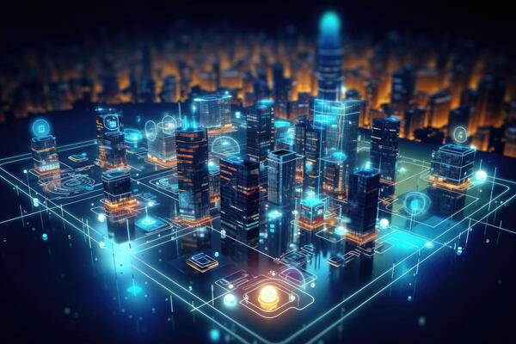
Real-Time Simulation Tool For Proactive Urban Heat Island Mitigation using Geographic Information System with Digital Twin Technology Integration.
IT21802058 | Madhuwantha G K O | R25 - 002

Slide 52

Introduction
Develop a real-time simulation tool to mitigate Urban Heat Island (UHI) effects.
Enables proactive decision-making for sustainable urban development.
IT21802058 | Madhuwantha G K O | R25 - 002

Slide 53


Research Gap
Paper A: "Current UHI mitigation approaches are mostly reactive, addressing problems after they occur rather than preventing them through predictive modeling.“ [1]
Paper B: "Existing simulation tools do not effectively integrate digital twin technology with real-time GIS data and environmental parameters like wind flow and solar radiation.“[2]
Paper C: "Digital twin applications in urban planning are underutilized for UHI mitigation, often focusing on static analyses like energy management instead of dynamic thermal simulations.“[3]
IT21802058 | Madhuwantha G K O | R25 - 002
Notes:
The first research I’d like to discuss explores the use of low-cost IoT sensor nodes for detecting Urban Heat Islands. These sensors measure temperature and humidity, offering a cost-effective and real-time solution for monitoring. However, while effective, this approach doesn’t integrate with mapping systems. This means it lacks the ability to precisely align temperature readings with specific geographic locations, which limits its utility for urban planners.
Next is the Citi-Sense-Mob project, which took an innovative approach by involving citizens in environmental data collection. This project focused on air quality and CO2 emissions, providing valuable environmental data relevant to UHI detection. However, it falls short in measuring precise temperature data, which is a critical requirement for accurate UHI hotspot identification.
Finally, let’s look at a study that used Landsat satellite imagery to analyze UHI effects in South Sumatra. Landsat provides thermal and land-use images, making it a great tool for large-scale monitoring. But again, there’s a limitation—it only provides an overview. It cannot capture precise, localized temperature data, which is essential for creating actionable mitigation strategies.
These studies highlight gaps in precision, integration, and real-time capabilities and they are the gaps my research component aims to bridge, combining IoT, thermal imaging, and geospatial mapping into one cohesive and scalable system.

Slide 54
Research Questions
How can digital twin technology and GIS data be integrated to simulate thermal impacts in urban environments?
What are the key environmental parameters needed to accurately predict Urban Heat Island (UHI) effects?
How can a simulation tool provide actionable insights for UHI mitigation and sustainable urban planning?
What algorithms and methodologies can enhance the accuracy of thermal impact simulations?
How can the tool be designed to support scalability and usability for diverse urban scenarios?
IT21802058 | Madhuwantha G K O | R25 - 002

Slide 55
Specific and Sub Objectives
1
Development of the Simulation Tool.
Develop a real-time simulation tool that integrates digital twin models with Geographic Information Systems (GIS) and environmental data to address Urban Heat Island (UHI) mitigation.
2
Integration of Environmental Data.
3
Thermal Impact Analysis.
4
Validation and Refinement.
IT21802058 | Madhuwantha G K O | R25 - 002

Slide 56
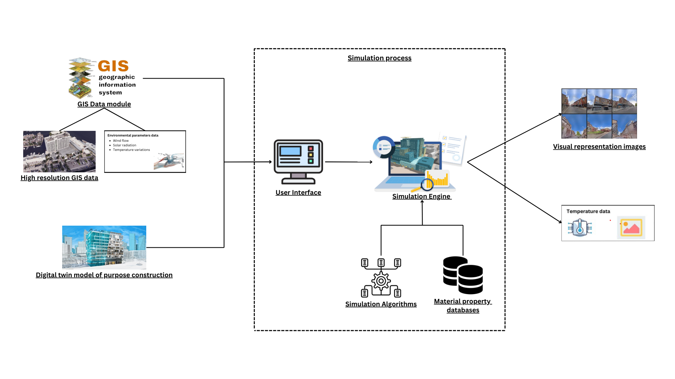
Methodology
System Diagram
IT21802058 | Madhuwantha G K O | R25 - 002

Slide 57
Technologies to be used
Algorithms
Heat Transfer and Thermal Modeling Algorithms (FEM)
CFD
Solar Radiation Algorithms
Geospatial Algorithms
Optimization Algorithms (GAs)
Programming Languages and Frameworks
Python
MATLAB
Node.js
PostgreSQL with PostGIS
Tools and Software’s
AutoCAD
Revit
QGIS
ARCGIS
ENVI-met
Custom Algorithms
OpenWeatherMap API
IoT Sensors
Techniques
Digital Twin Modeling
GIS Integration
Environmental Parameter Integration
Data visualization
IT21802058 | Madhuwantha G K O | R25 - 002
IT21802058 | Madhuwantha G K O | R25 - 002

Slide 58


System, Personal, and Software Requirements Specifications
System Requirements.
Hardware Requirements. (minimum : 16GB Ram, quad-core processor, 500GB HDD)
Software Requirements. (GIS platform, 3D modeling tools, python and MATLAB)
Non-Functional Requirements.
Scalability
Performance
Accuracy
Compatibility
Usability
Security
Functional Requirements
Importing Digital Twin Models
GIS Data Integration
Simulation Execution
Thermal Impact Analysis
Actionable Recommendations
Data Visualization
User Requirements.
Accessibility
Easy of Use
Customization
IT21802058 | Madhuwantha G K O | R25 - 002

Slide 59
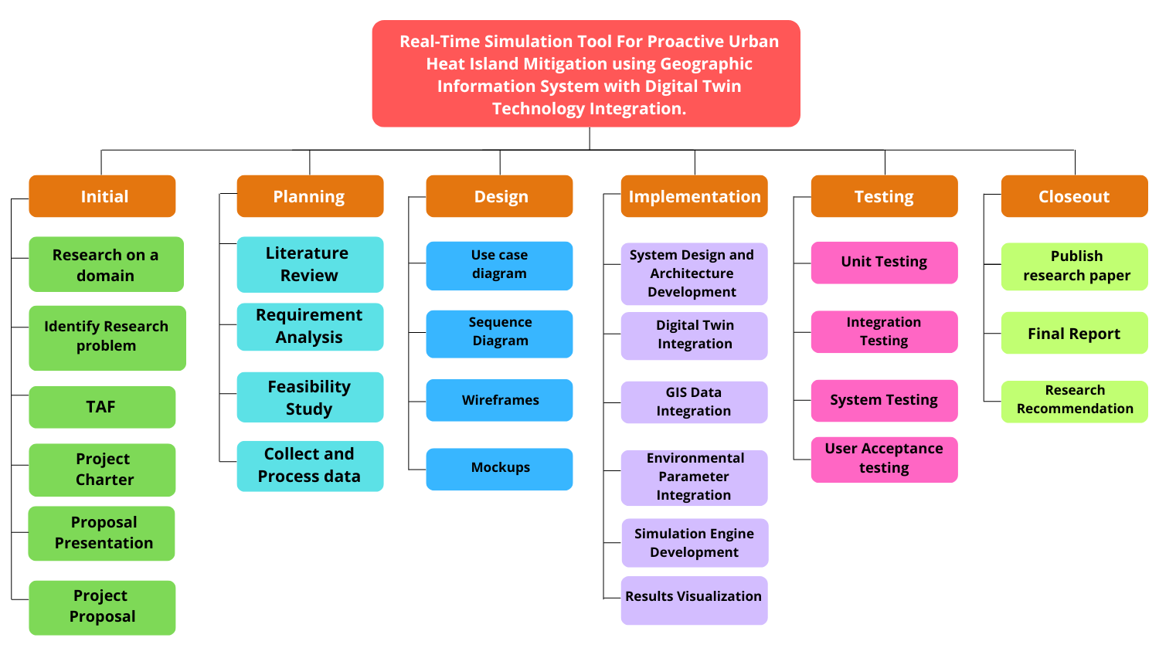
Work Breakdown Structure
IT21802058 | Madhuwantha G K O | R25 - 002

Slide 60
Gannt Chart
IT21802058 | Madhuwantha G K O | R25 - 002

Slide 61
Commercialization
Market space
Target Audience and Market Space
Urban Development Sector
Construction and Real state Market
Sustainability Consulting Firms
Urban planners and Architects
Environmental Researchers
Smart city Developers
Constructions and Real Estate Developers
Government Agencies and Policy Makers
IT21802058 | Madhuwantha G K O | R25 - 002

Slide 62
Budget Plan
Requirement | Price (Rs.)
Cloud Computing Service | 10000
Domain Registration | 4000
Hardware Products | 30000
Wi-fi charges | 6000
Transportation | 5000
Other | 5000
Total estimated cost | 60000
IT21802058 | Madhuwantha G K O | R25 - 002

Slide 63
References
[1] Junjing Yang, Mat Santamouris, "Urban Heat Island Mitigation Technologies in Asian and Australian Cities, - mpact and Mitigation " MDPI, 2018.
[2] Mustafa Ersan, Erdal Irmak, and Alperen Mustafa colak, "Application, Insights and Implications of Digital Twins in City Management" Proceedings of the IEEE Conference on International Conference on Smart Grid (icSmartGrid) 2024.
[3] Daoguang Yang, Hamid Reza Karimi, Okyay Kaynak, Shen Yin "Developments of Digital Twin Technologies in Industrial, Smart City, and Healthcare Sectors: A Survey," in ResearchGate, 2021
IT21802058 | Madhuwantha G K O | R25 - 002

